Slide 1
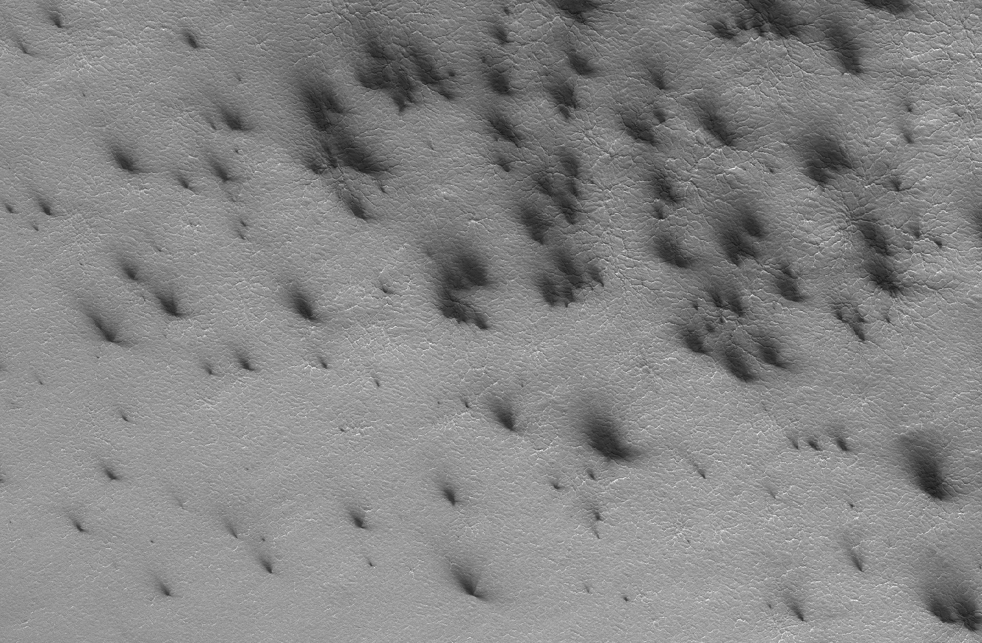


CHARACTERIZING THE EVOLUTION OF MARS SOUTH POLAR JETS AND FANS.
By
Étude Aro O’Neel-Judy
Dr. Timothy Titus
In association with
The NASA Space Grant Program at Northern Arizona University and The United States Geological Survey

Slide 2

What is this project?
Mars has four seasons just like Earth.
In the fall and winter, approximately 25% of the Martian atmosphere freezes into a meter thick slab on the south pole.
The global CO₂ cycle is one of the primary drivers of planetary weather on Mars.
South Polar Jets and Fans are seasonal processes that occur in the south polar spring.
These phenomenon are intimately involved with the global CO₂ cycle.
Studying these phenomenon is vital to attaining a clear understanding of the Martian climate as a whole.

Slide 3
Let’s learn some background.
In Spring, sunlight penetrates the semi-translucent temporary cap.
Image credit Pommerol et al 2011
The ground underneath the ice warms the underside of the ice, producing a phenomenon called basal sublimation.
Basal sublimation causes gas pressure to build under the ice, resulting in explosive CO₂ jets.
Note: Sublimation is the process where a solid transitions into a gas with no intermediate liquid phase.

Slide 4
More background.
The CO₂ jets bring dust up from under the ice and blasts it into the air.
This ejected dust then settles to form fans (see background), which are often oriented in the same direction as the local wind.
The lengths of these fans are determined by gas pressure, wind speed, and local topography.
Image credit Kieffer et al 2006
Note: Basal sublimation is the process where the underside of a material transitions from a solid to a gas.

Slide 5
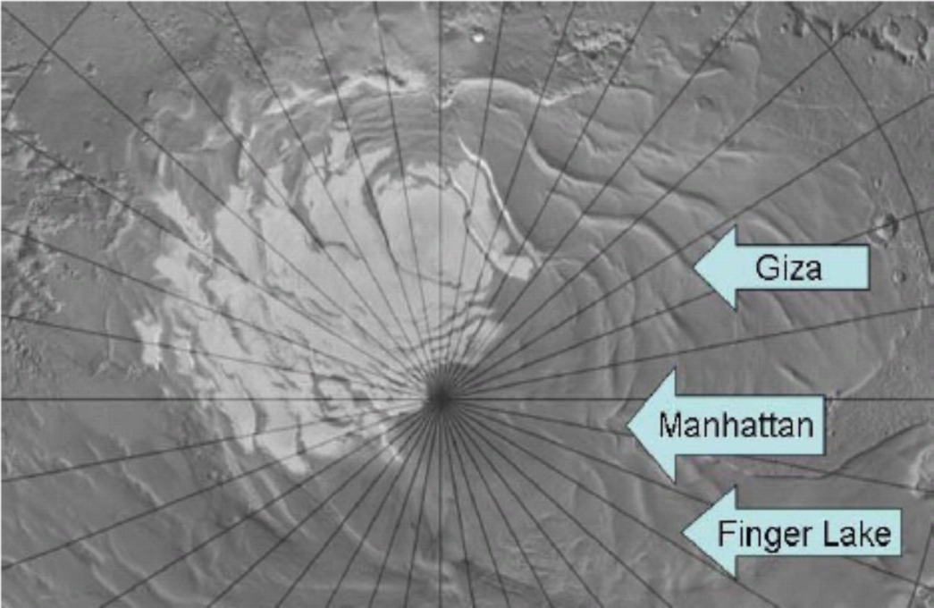
What did we do?
We wanted to see whether local wind conditions played a dominant role in the formation of fans.
We then compared our length plots to data from a global wind model called the Ames Mars General Circulation Model (MGCM).
We studied three regions of interest (ROIs), which are informally named Manhattan, Finger Lake and Giza.
We used images taken by the Compact Reconnaissance Imaging Spectrometer (CRISM) and Thermal Emission Imaging System (THEMIS) cameras orbiting Mars to analyze fan lengths.

Slide 6
The meat: Data Analysis
Average fan length plotted as a function of season (Ls). Finger Lake (black), Giza (green).
Wind speed from MGCM plotted as a function of season (Ls). Finger Lake (black), Giza (green).
Both fan length and wind speed increase between Ls 185⁰ and 195⁰. We see another such increase around Ls 225⁰.

Slide 7
The good stuff: What did we find?
There is a positive correlation between MGCM data and our measurements, suggesting that wind speed plays a prominent role in fan formation.
Towards the end of Spring (when the ice is thinning), we see fan lengths decrease in Giza while local winds are stronger than ever.
This suggests that although wind speed is a powerful player when it comes to fan length, we also have a dependence on internal gas pressure within the slab.

Slide 8



Thank you for listening!
Much thanks to the NASA Space Grant program for providing me with this opportunity.
Thanks to Tim Titus for his unending patience and guidance throughout the project.
Thanks to Kathleen Stigmon and Nadine Barlow for helping and guiding me through the program.
Thank you, I appreciate your attention.

Slide 9
What Next?
We want to refine our study by using a more localized wind model to simulate wind speeds.
Areas with unique topography require further study to better understand the conditions that form the length trends we observe.

